Slide 1
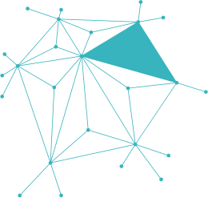
DEEPGUARD
CONTEXT-AWARE MULTIMODAL
MISINFORMATION DETECTION WITH EXPLAINABLE AI

Slide 2
PRESENTED BY:
  Khadijah Irfan SP-23/BSSE/025
  Zujajah Khan SP-23/BSSE/031

Slide 3

INTRODUCTION
DeepGuard is an AI-powered multimodal system designed to detect manipulated digital content by analyzing both textual and visual information.

Slide 4
The system combines:
• Fake News Detection
• Image Manipulation Detection
• Sentiment Analysis
• Metadata Analysis
• Context Mismatch Detections.
Goal
Provide reliable verification of suspicious online content

Slide 5
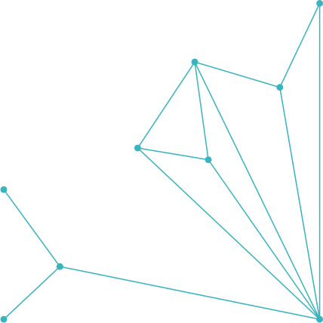
PROBLEM STATEMENT
Fake and manipulated content spreads rapidly across social media
  Current system focus on Text only or Image only
They fail when:
  Fake text uses real image
  Real text uses fake image
  Text and Image contradict each other

Slide 6
Result:
Misleading information reaches millions of users.

Slide 7

PURPOSE & OBJECTIVES
  Detect fake news from textual content
  Analyze sentiment patterns
To develop an intelligent system capable of detecting manipulated content using multiple AI techniques.
  Detect text-image inconsistencies
  Detect manipulated or synthetic images
  Explain AI decisions using Explainable AI
  Analyze metadata indicators

Slide 8
PROJECT SCOPE
Included:
✓ Text-based fake news detection
✓ Image authenticity analysis
✓ Metadata analysis
✓ Sentiment analysis
✓ Explainable AI
✓ Web-based interface

Slide 9
Excluded:
✗ Live social media crawling
✗ Video deepfake detection
✗ Multilingual support (future work)

Slide 10
FUNCTIONAL REQUIREMENTS
FR-1: User can enter news/article text
FR-2: User can upload an image
FR-3: System analyzes text using AI models
FR-4: System analyzes image content

Slide 11
FR-5: System performs metadata analysis
FR-6: System performs sentiment analysis
FR-7: System generates final verdict
FR-8: System displays confidence score
FR-9: System explains prediction results

Slide 12
NON-FUNCTIONAL REQUIREMENTS
Performance
• Response time under 5 seconds Usability
• Simple and responsive interface Reliability
• Accurate prediction results

Slide 13
Scalability
• Modular architecture
Maintainability
• Independent modules
Security
• Secure file upload handling

Slide 14
EXTERNAL INTERFACE REQUIREMENTS
Hardware Interface
Software Interfaces
• Flask Framework
• PyTorch
• HuggingFace Transformers
• OpenCV
• VADER Sentiment
User Interface
• Dashboard
• Detection Page
• Results Page
• Modules Page
• About Page
  Desktop/Laptop
  Internet Browser

Slide 15

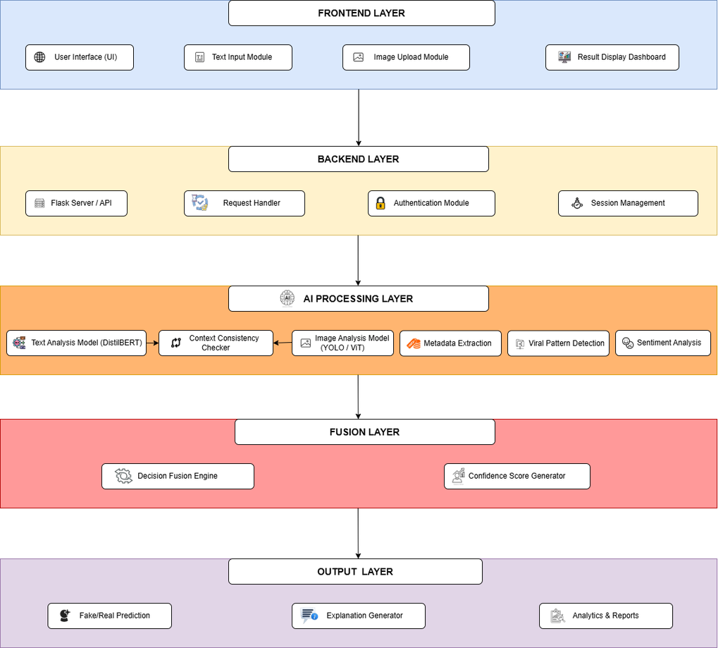
SYSTEM ARCHITECTURE

Slide 16
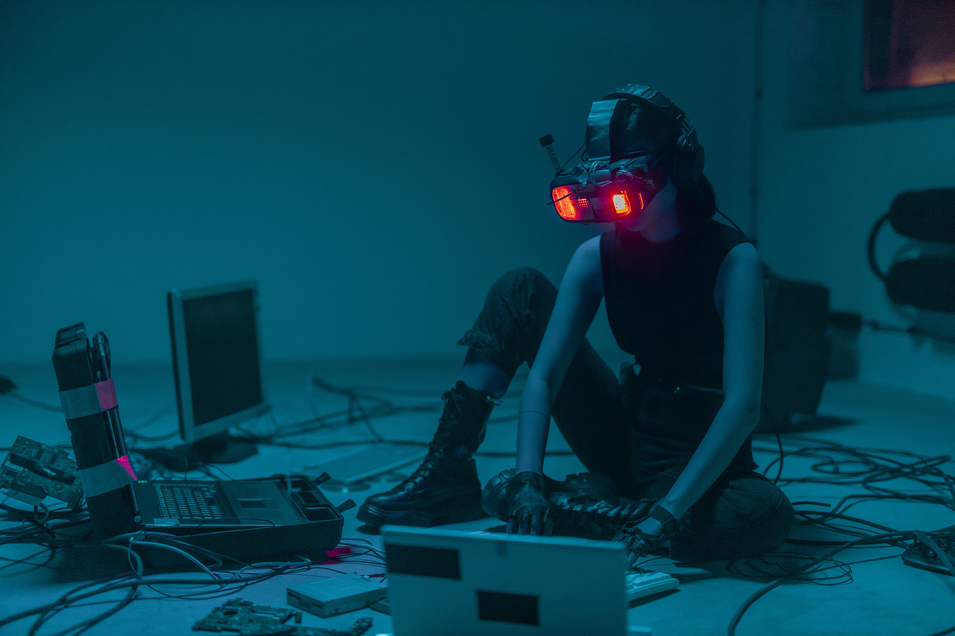
TECHNOLOGY STACK
FRONTEND:
HTML5, CSS3, JavaScript

Slide 17
BACKEND:
Flask, Python
AI FRAMEWORKS:
  PyTorch
  Hugging Face

Slide 18
DATABASE:
SQLite
VERSION CONTROL:
GitHub

Slide 19
CURRENT PROGRESS & FUTURE WORK
COMPLETED:
• Literature Review
• SRS Documentation
• System Architecture Design
• Dataset Collection
• Technology Stack Selection
• Text Analysis Module Development
• DistilBERT Model Training
  Sentiment Analysis

Slide 20
IN PROGRESS:
• Image Analysis Module
• Metadata Analysis
REMAINING:
• Context Mismatch Detection
• Explainable AI (SHAP)
• System Integration & Testing
Overall Project Progress: 40%

Slide 21
ANY QUESTION?
THANKYOU

